Slide 1

2017
LA Homeless Report
Naiyuan Xiao, Mohamad Ganji
Wei Tang, Muhammad Musthofa
Modan Wang , Yufei Wang
Notes:
1-5 Xiao
6-10 Gloria
11-18 Yakan
10

Slide 2
1/ Project Introduction
2/
Descriptive Statistic
3/ Regression Analysis
AGENDA
4/
Geospatial Dashboard
5/ Conclusion

Slide 3

01
Project Introduction

Slide 4
Project Goal
“
Main Goal: Support the Mayor’s goal to reduce the absolute number of homeless
Present descriptive statistics for 311 calls and crimes.
Find the relationships among main variables.
Visualize different measures on the map.
“

Slide 5
Data Set
Crimes
311 Calls
Living Condition of the Homeless People
Shelters
Area Condition
Homeless Count
Population

Slide 6

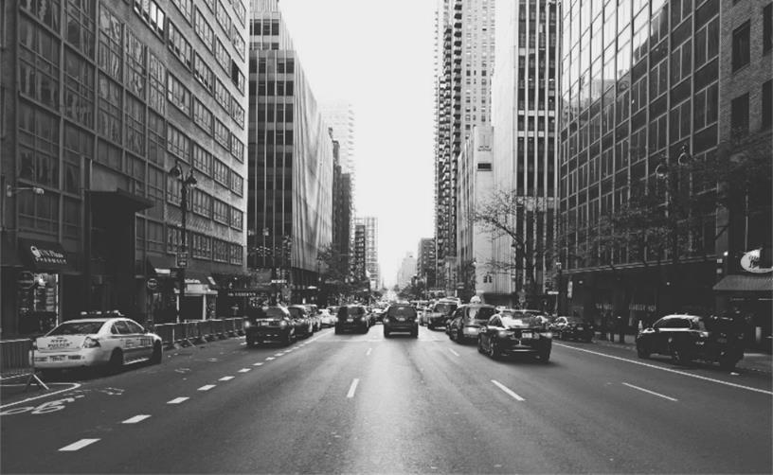
Assumption
The number and location of homeless people will not change in short time if there is not any shelter change.
Current homeless people will not move in or move out of LA county.

Slide 7
02
Descriptive Statistics

Slide 8
311 Homeless Encampment Requests
Provided data: August 2015 – November 2017
Type of Analysis:
Source analysis: request source, request efficiency, etc.
Time analysis: total request by weekday and month.
Geospatial analysis:
# of encampment requests based on census tract and council district
Update rate based on census tract and council district
Geocoding (2015-2016 dataset): latitude and longitude -> census tract

Slide 9
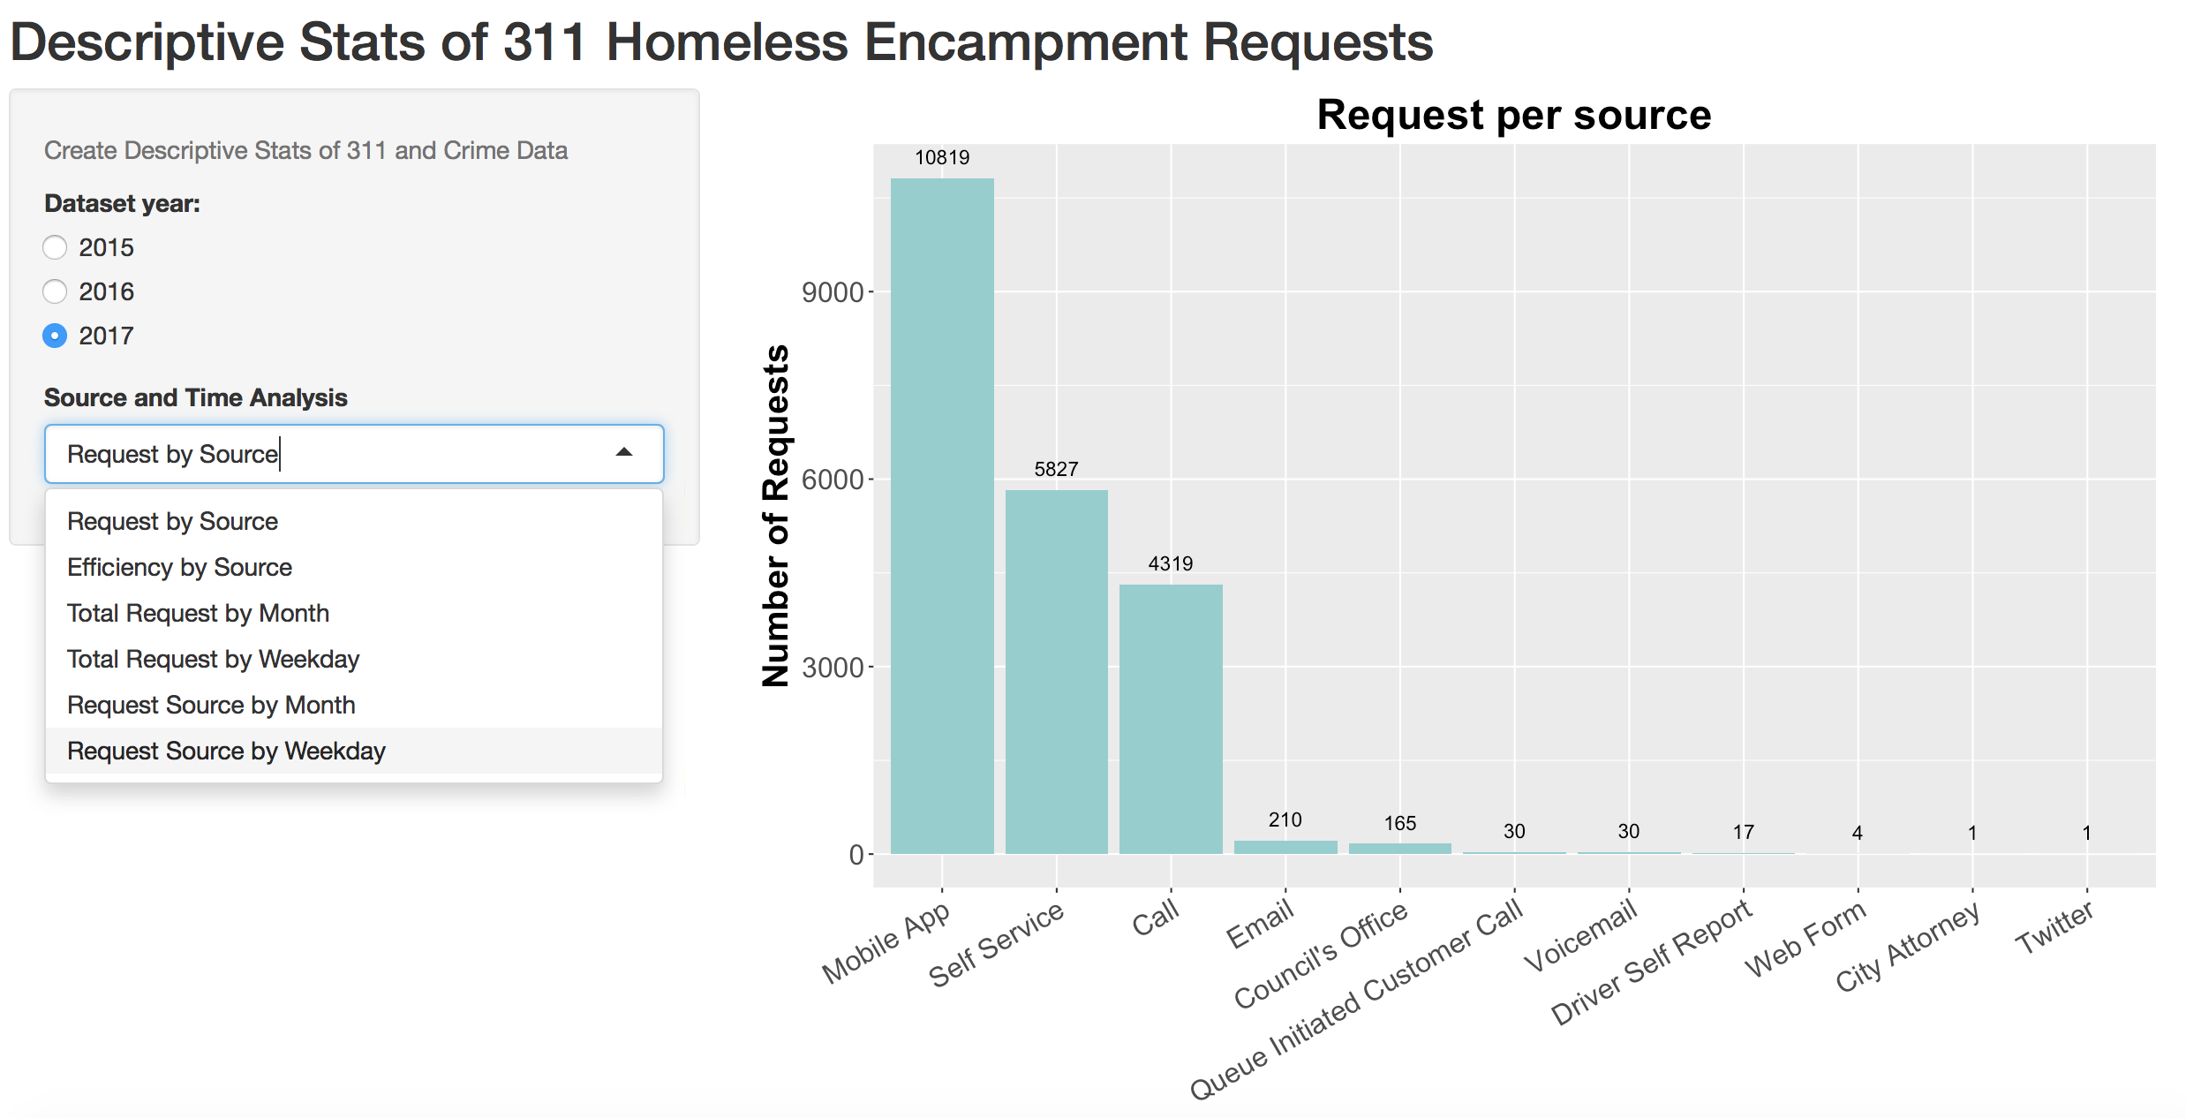
Descriptive Stats of 311 Homeless Encampment Requests

Slide 10
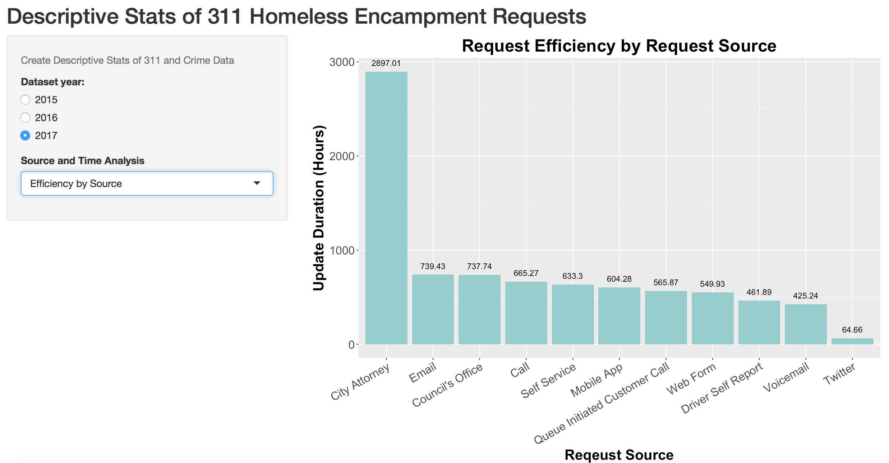
Descriptive Stats of 311 Homeless Encampment Requests

Slide 11
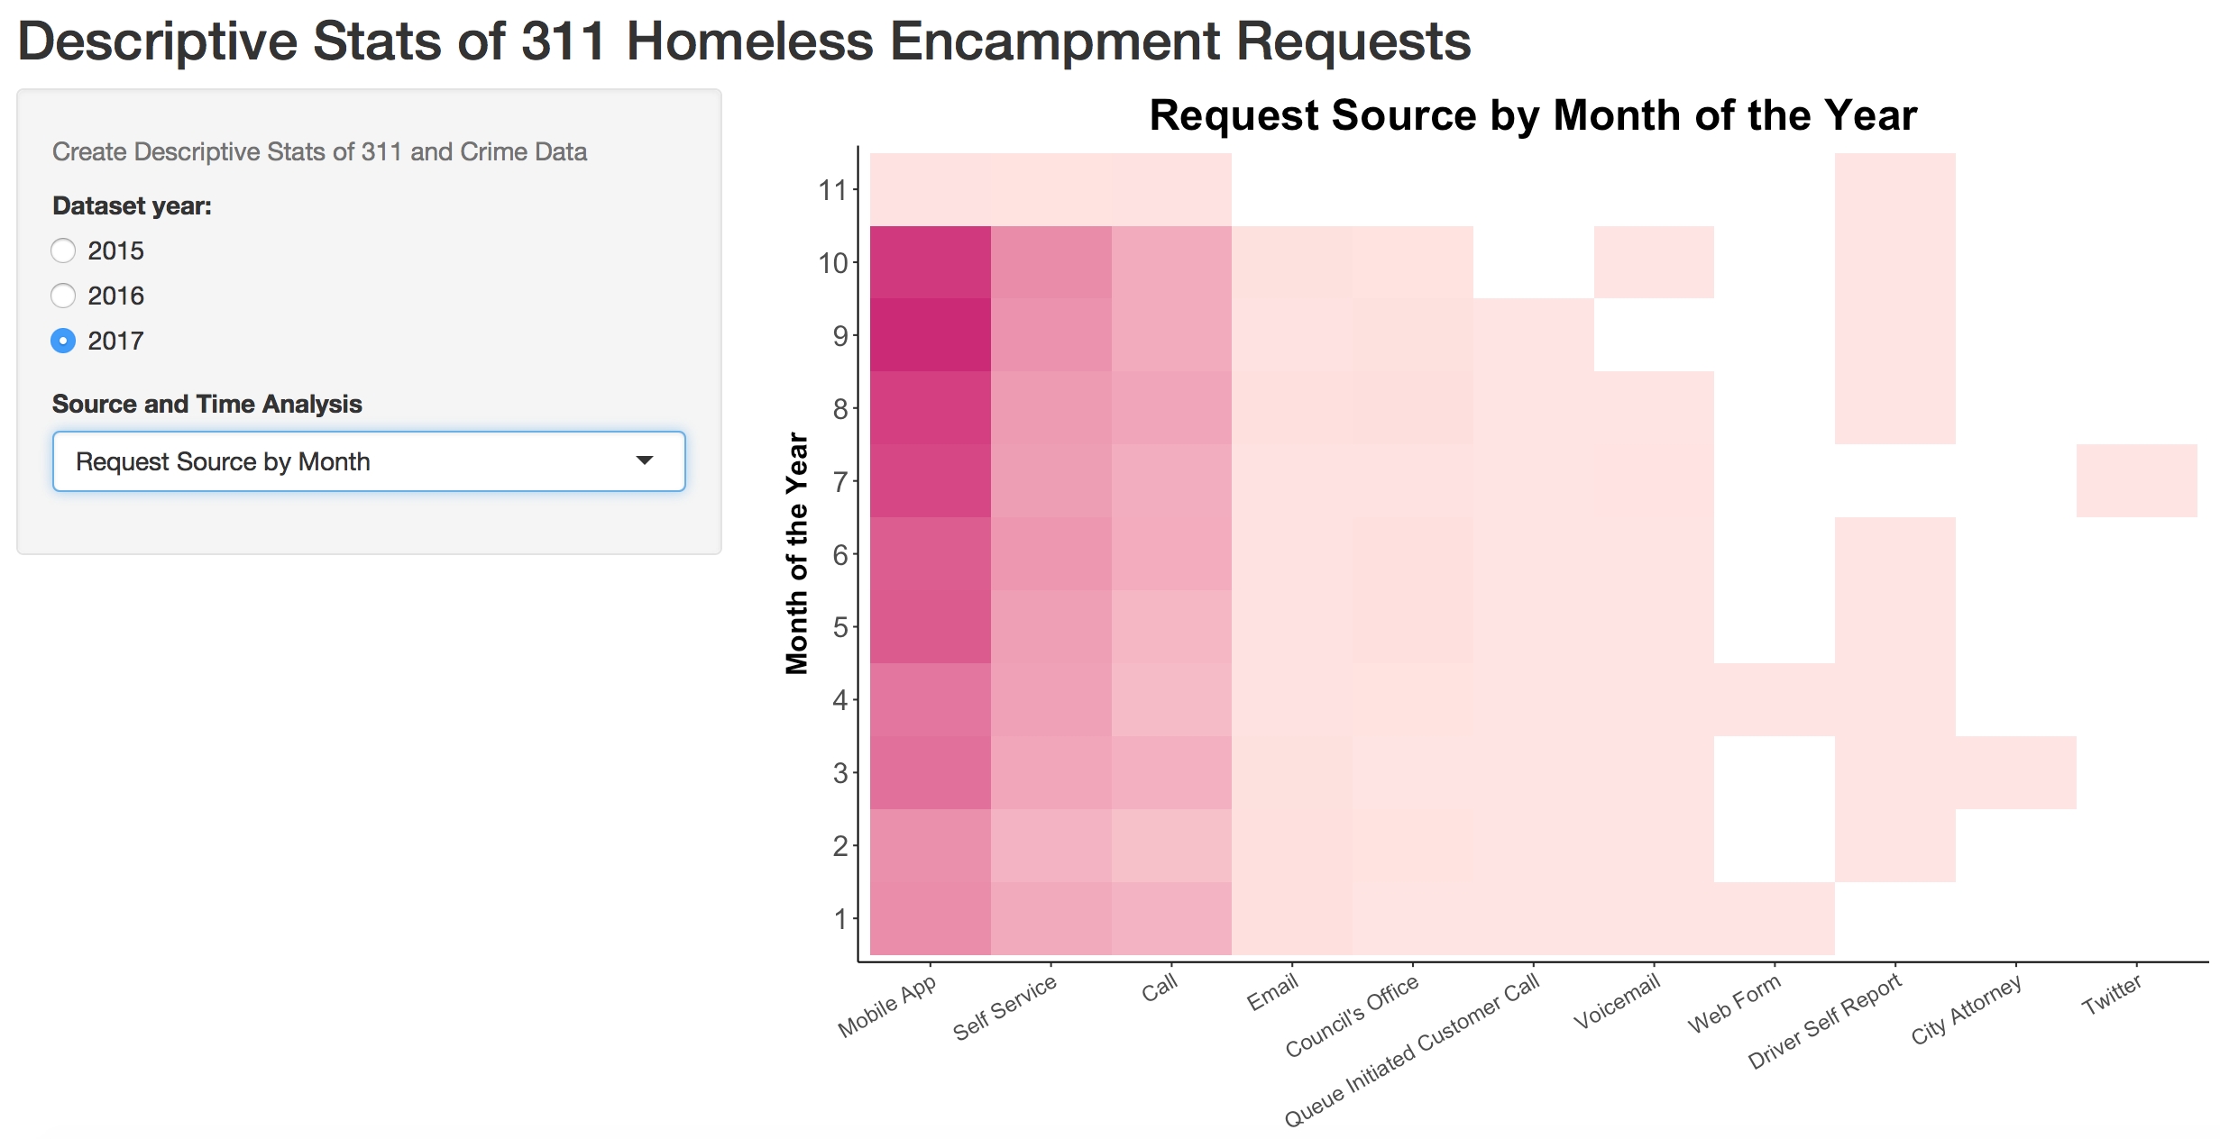
Descriptive Stats of 311 Homeless Encampment Requests

Slide 12
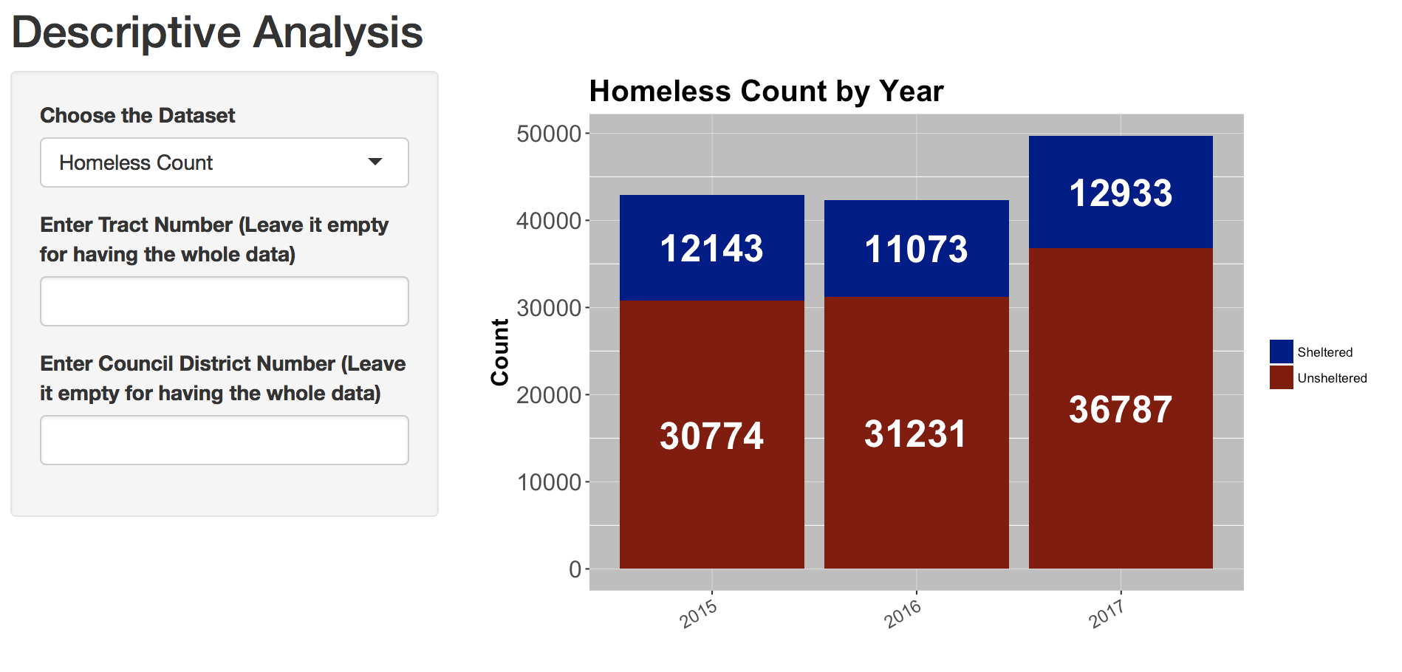
Homeless Population

Slide 13
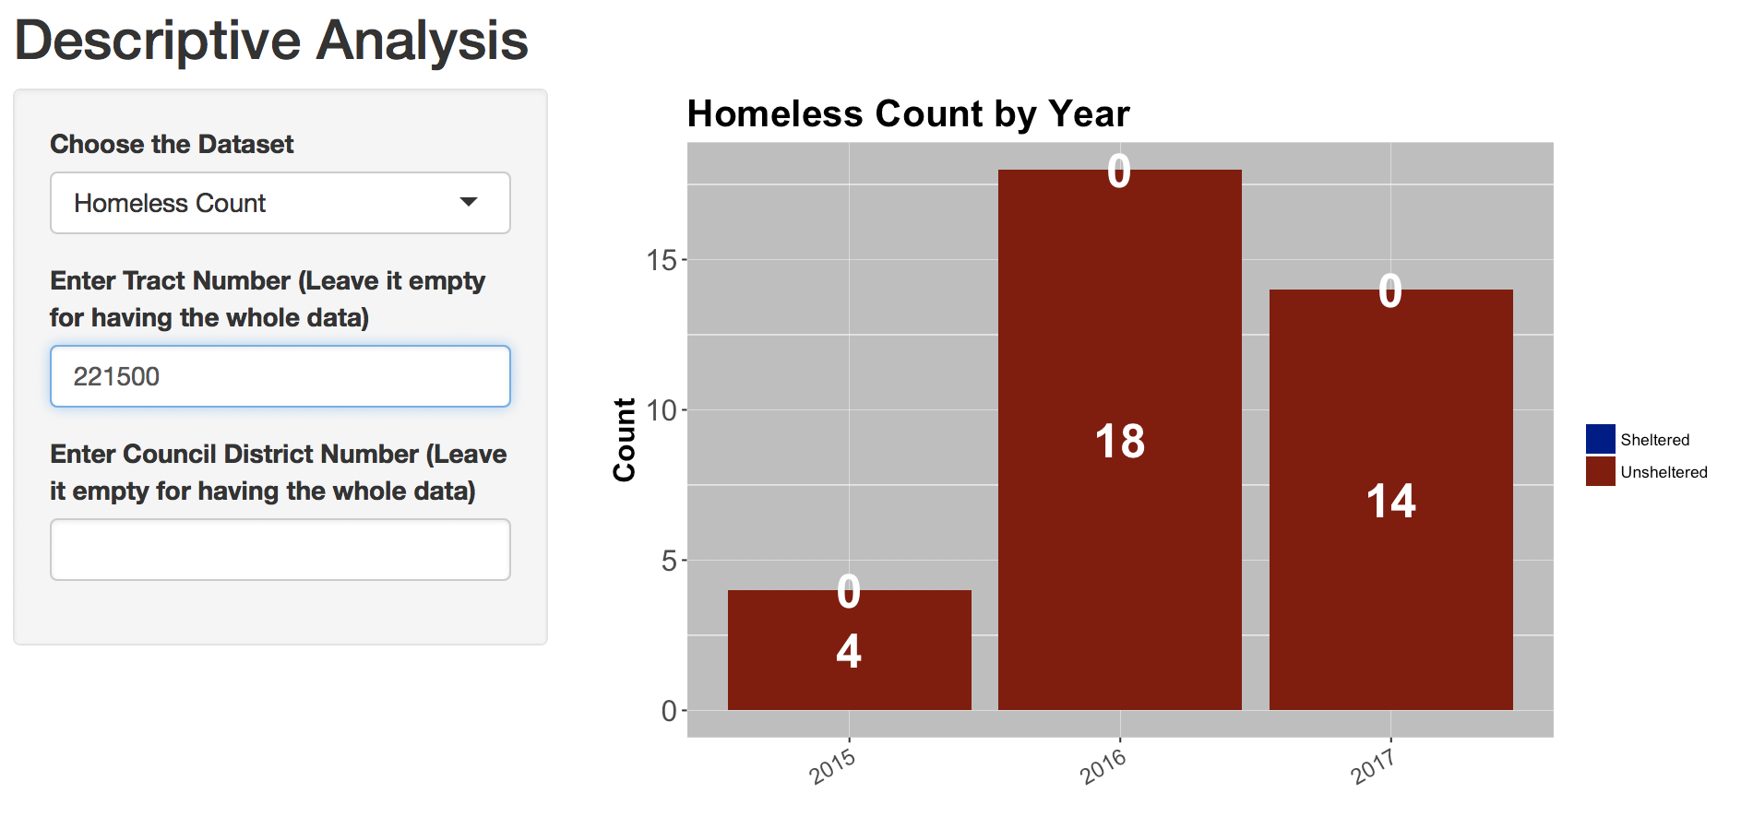
Homeless Population

Slide 14
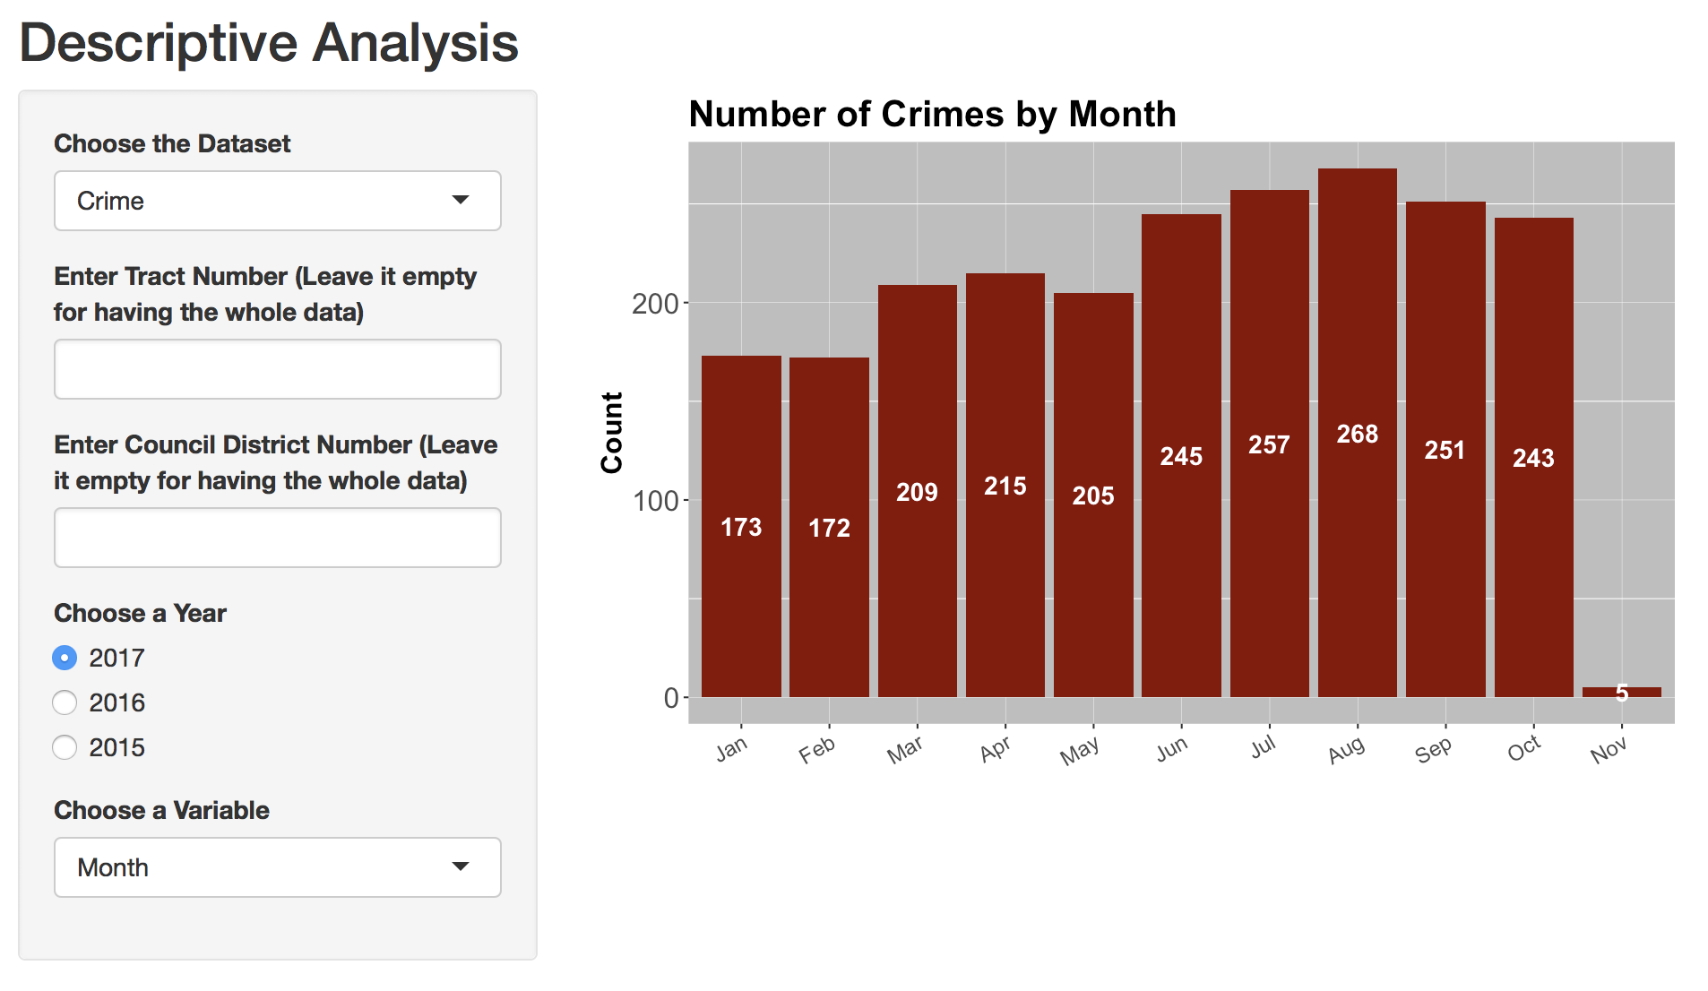
Crime Description

Slide 15
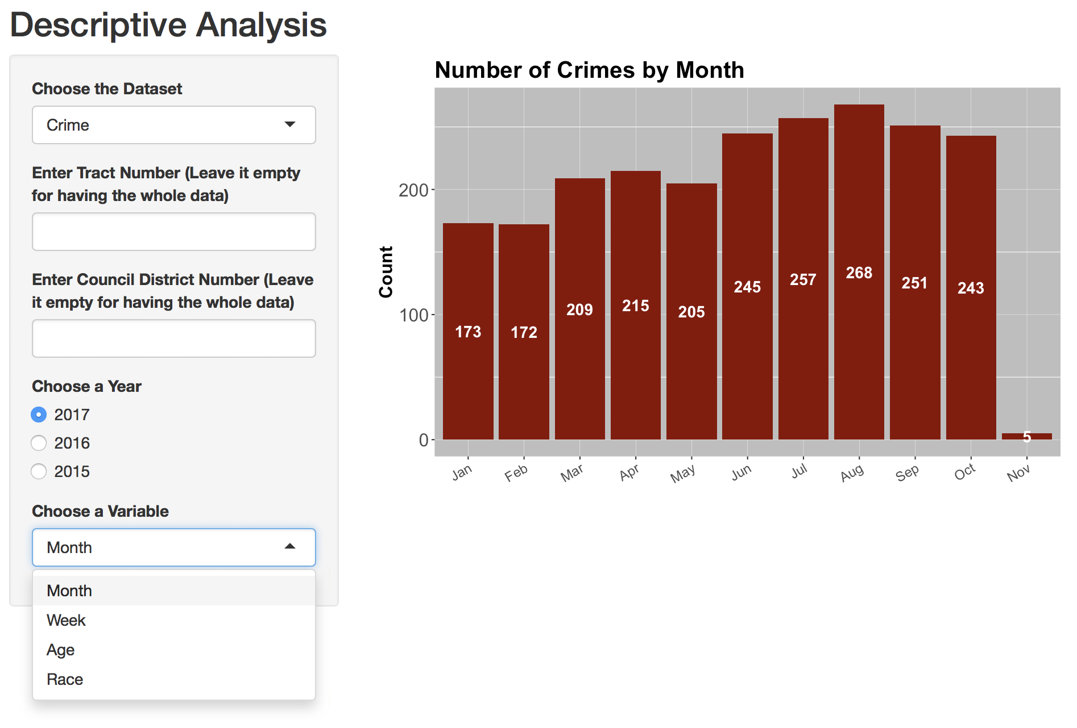
Crime Description

Slide 16
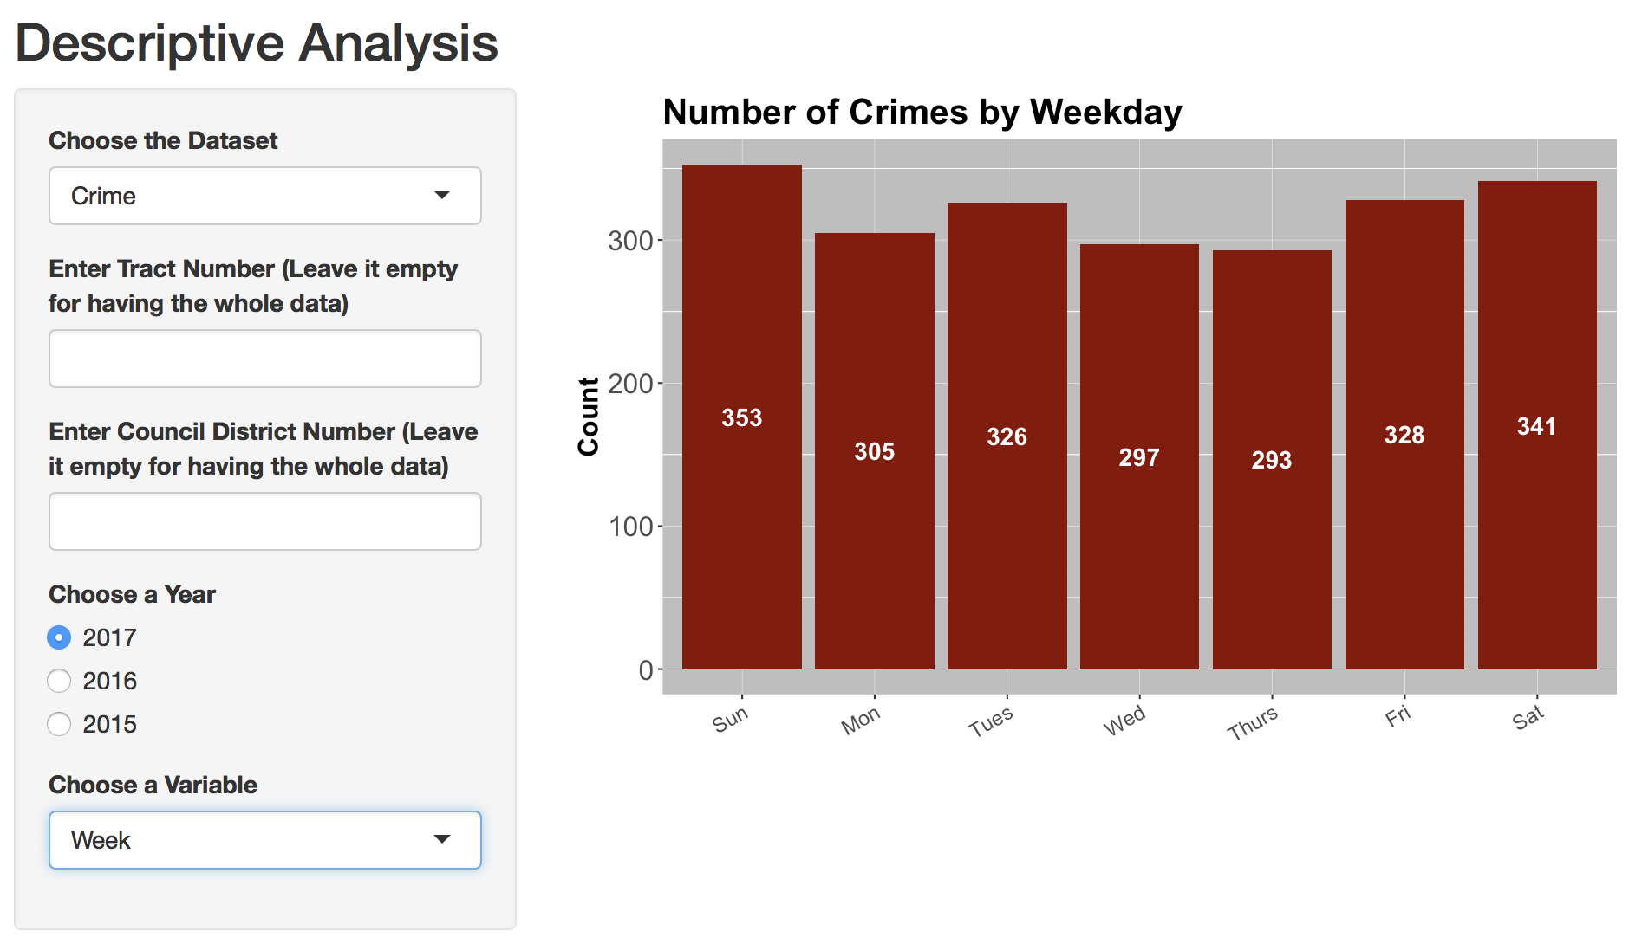
Crime Description

Slide 17
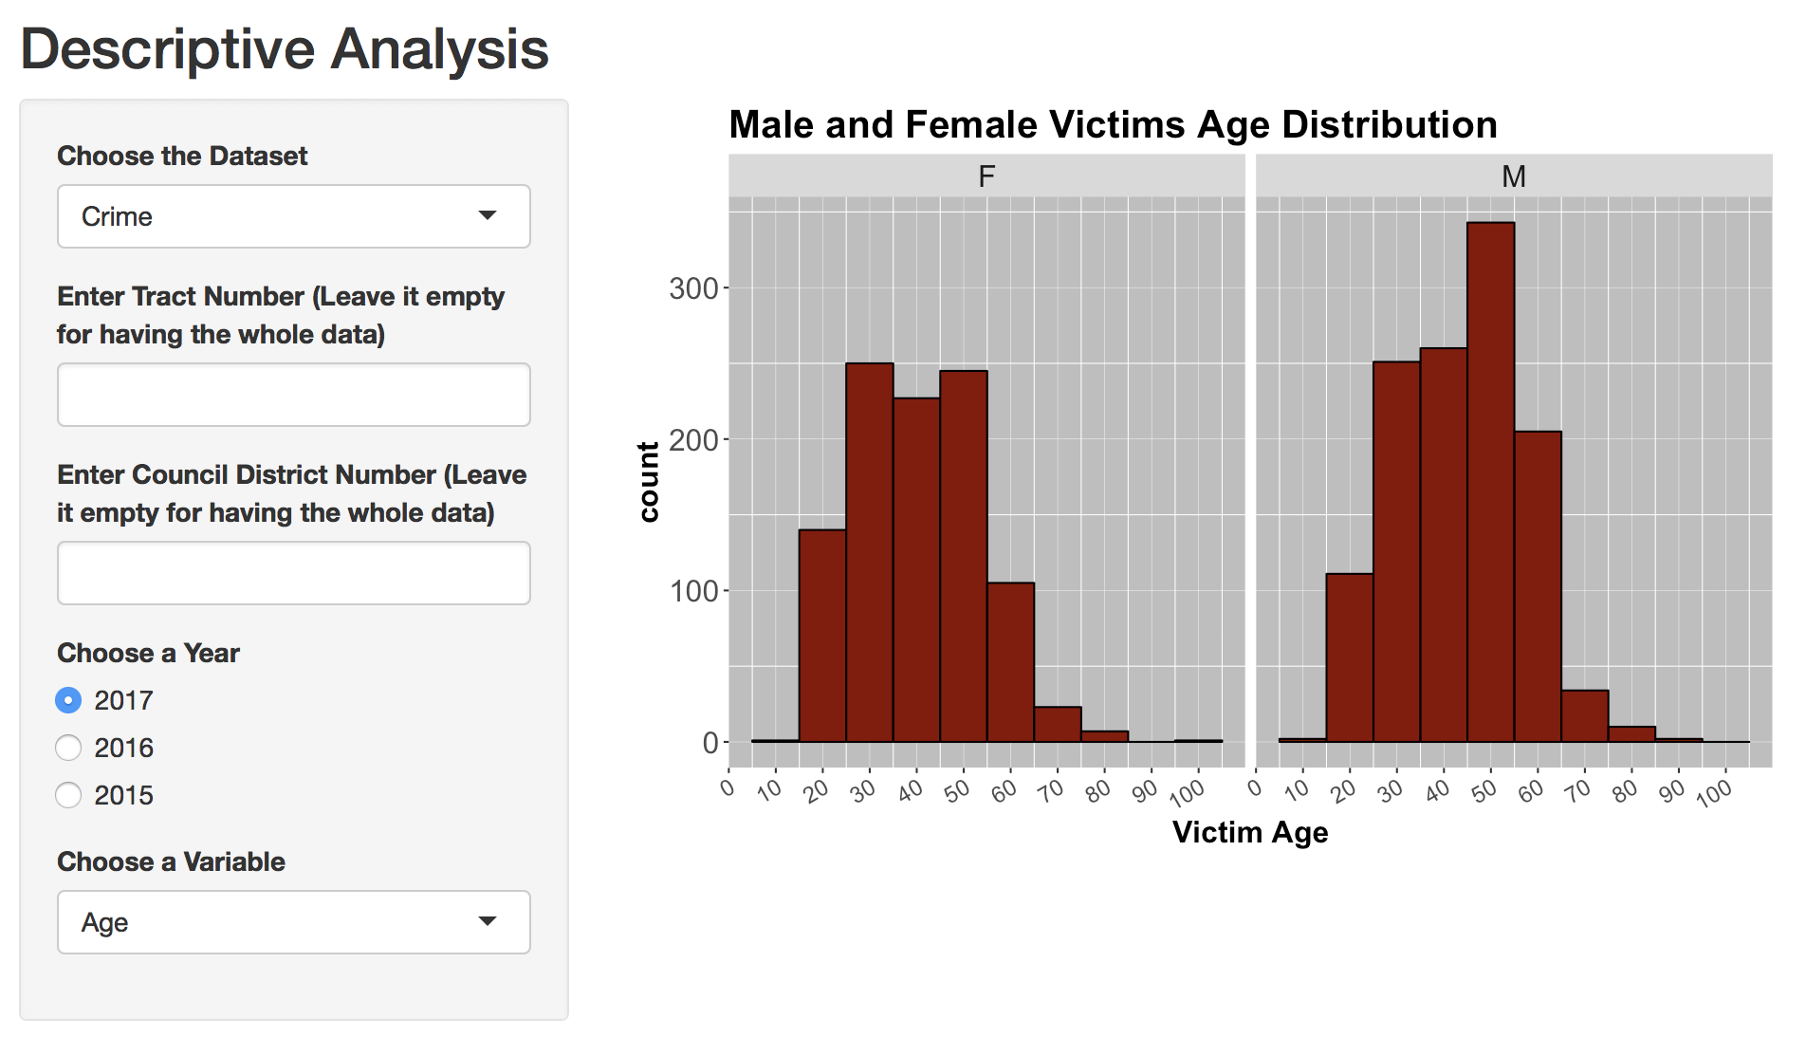
Crime Description

Slide 18
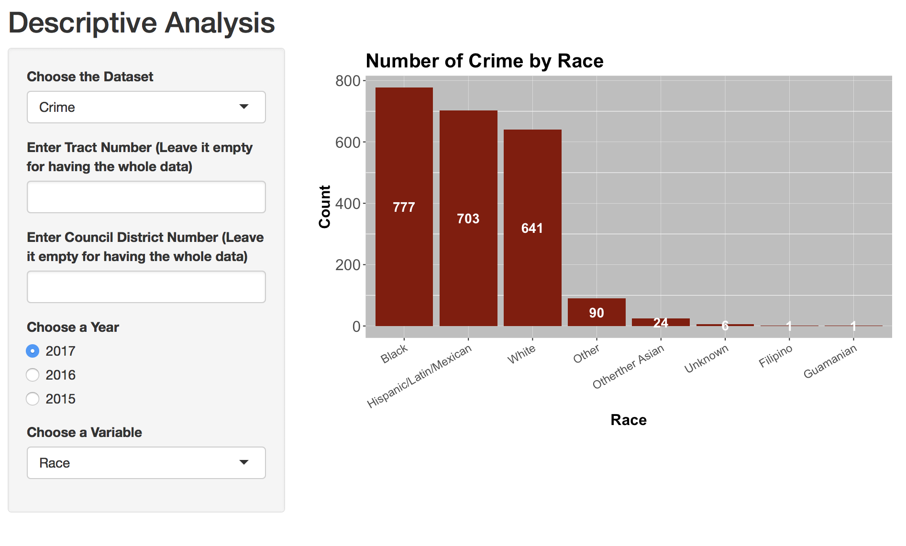
Crime Description

Slide 19
03
Regression Analysis

Slide 20
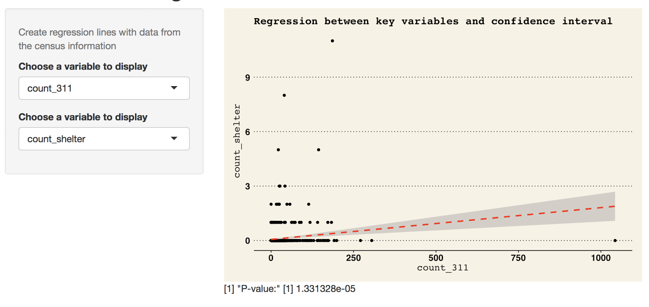
Shelter & 311 Calls

Slide 21
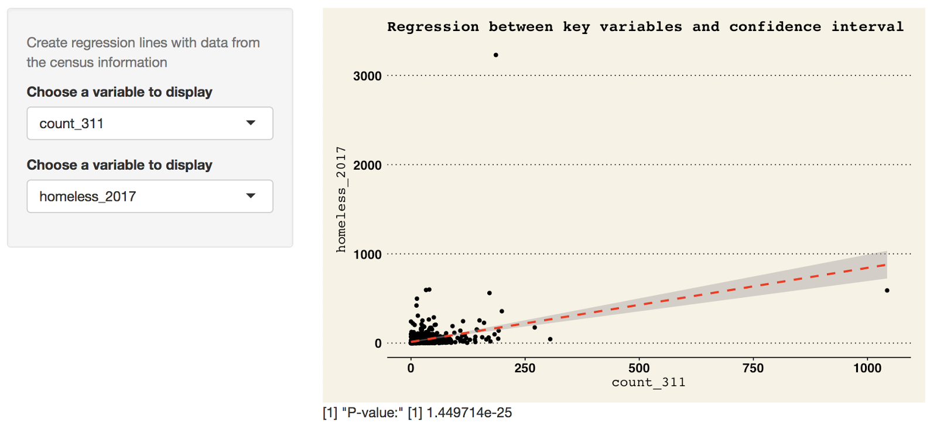
311 Calls & Homeless

Slide 22
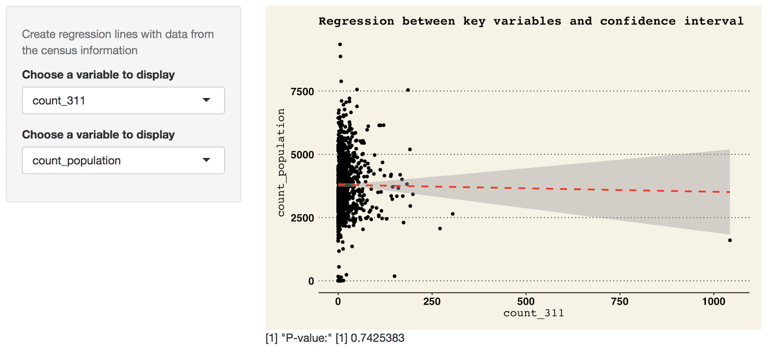
311 Calls & Population

Slide 23
04
Geospatial Dashboard

Slide 24
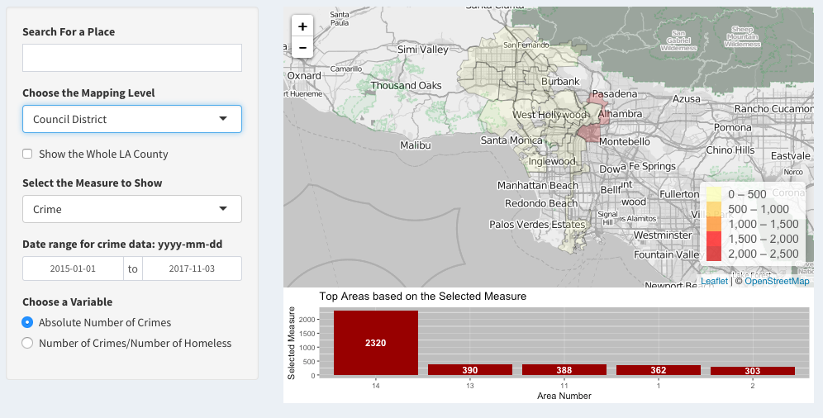
Geospatial Dashboard

Slide 25
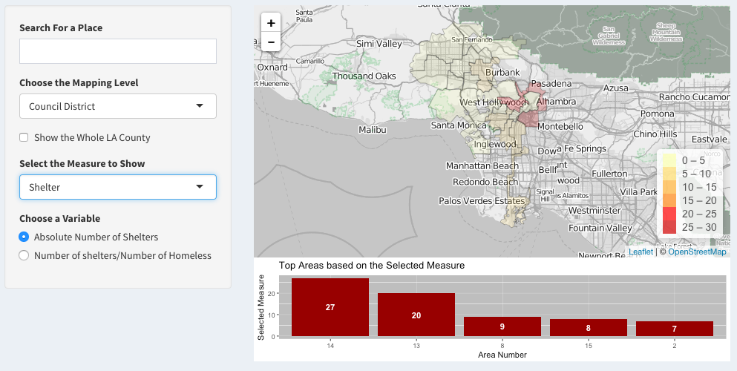
Geospatial Dashboard

Slide 26
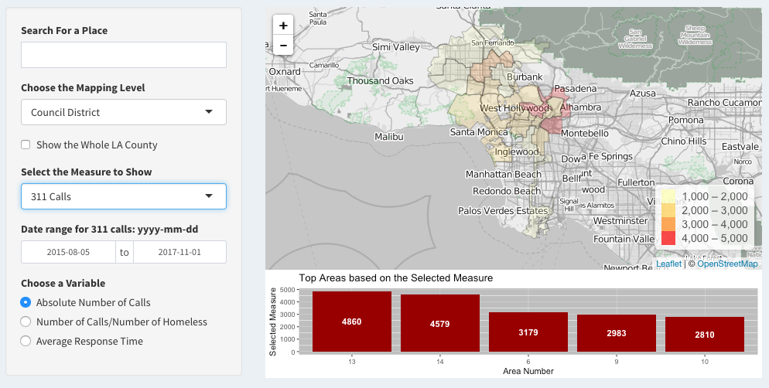
Geospatial Dashboard

Slide 27
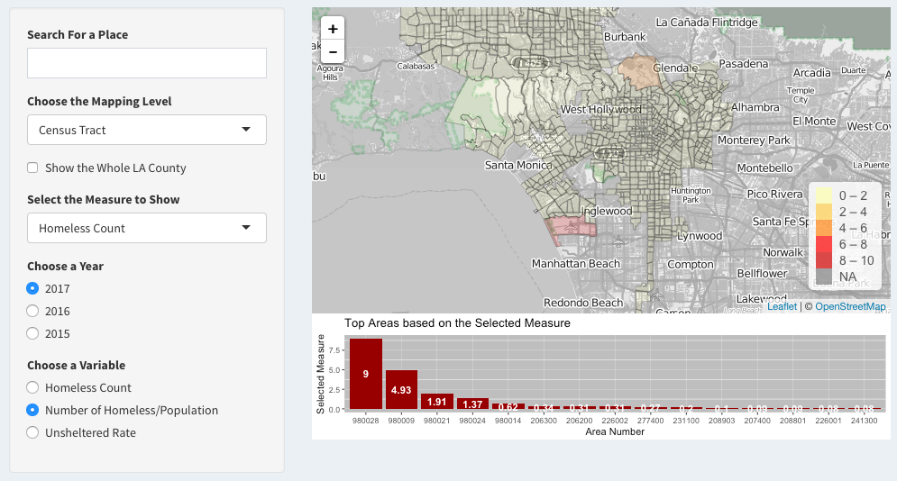
Geospatial Dashboard

Slide 28
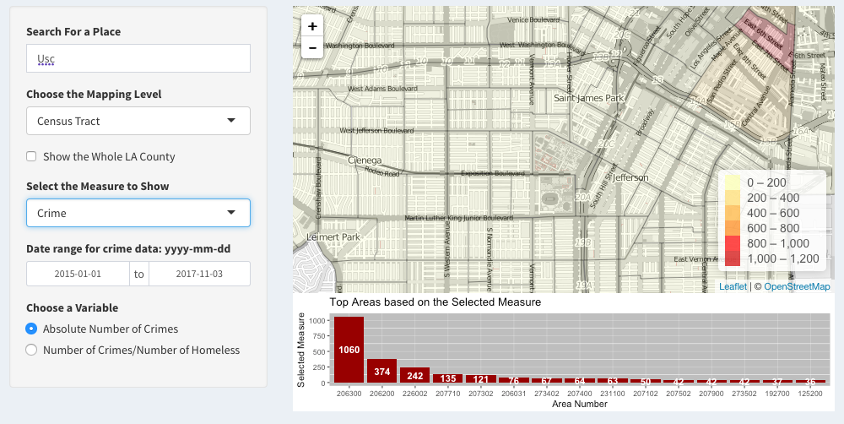
Geospatial Dashboard

Slide 29
05
Recommendation

Slide 30
Recommendation
“Where should the government build more shelters?”
Formula:
risk_index= 311_weight * count_311 / total_amount_of_311_calls +
crime_weight * count_crime / total_amount_of_crime +
shelter_weight * ( 1 - count_shelter / total_amount_of_shelter ) +
homeless_weight * count_homeless / total_amount_of_homeless

Slide 31
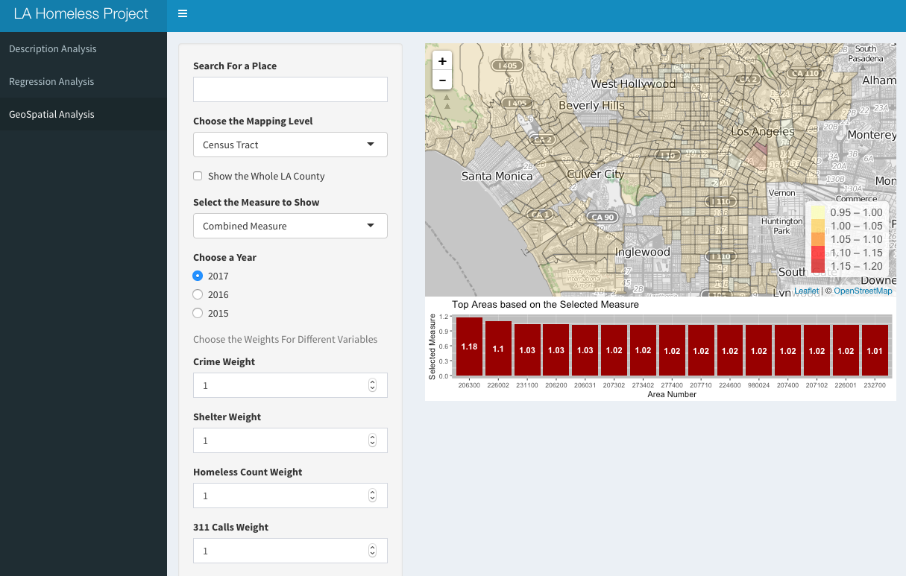
Recommendation

Slide 32
THANKS FOR LISTENING
Notes:
311 Calls & Shelters dataset: we want to do area zoning based on ZCTA, but some census tracts have several zip codes (homeless count and population dataset).
Homeless Count, Crime & Population dataset: is it ok to use SPA(Service Planning Area) / SD(Supervisorial District) /CD(Council District) or ZCTA(Zip Code Tabulated Area) divide area?

